Slide 1
YödelIt
Notes:
Hello Everyone! We are here today to introduce you to a new and exciting android application project! YodelIt! But, before we get any further, we just want to take a quick moment to introduce ourselves!

Slide 2

Inception
Notes:
Now, when we first heard about the requirements for this programming project, the first question that we asked ourselves was how can we make this application unique and different from all the others. We took a little bit of time, and found out that there are just a little over 1.4 million apps on the Play store! That is huge number, and it just keeps on getting bigger! Approximately about 40 000 new apps are added to the app store monthly! (http://www.appbrain.com/stats/number-of-android-apps) Now, with that much of a market, it becomes very difficult to get any attention whatsoever from consumers. And yet, there are some apps that are picked up by a sizeable percentage of users almost immediately! So, what exactly is the difference between these top 100 or so apps, and the remaining 1.4 million? The answer my friends is brand. It’s all about how we brand something. Our world looks for the new and interesting. Not the same, old repetitions. Why did Facebook and Twitter hit it big? Because, let’s face it, there are other companies out there that do exactly the same thing. The difference is in the lexicon, the jargon that makes members feel a sense of community. And that’s exactly what YodelIt aims to do. After a lot of thinking, Aedan here came up with the fabulous idea about goats! Now, I know what you’re all thinking. How do goats fit into a question and answer app? And that my friends is where the beauty of this app lies. Let’s take a moment to think ourselves over to the Swiss Alps. Pristine snow, awesome skiing, and a very rich culture. Now, let’s think ourselves back to the app with a bit of a Swiss influence. Let’s say I want to ask a question. Too 1973, eh? Instead, I’ll Yodel it over. And my good friends on the interweb will echo something back to me. New lexicon, new terminology. Something to set this app apart from the rest. But it just doesn’t stop there. Let’s take you through the app to see more.

Slide 3
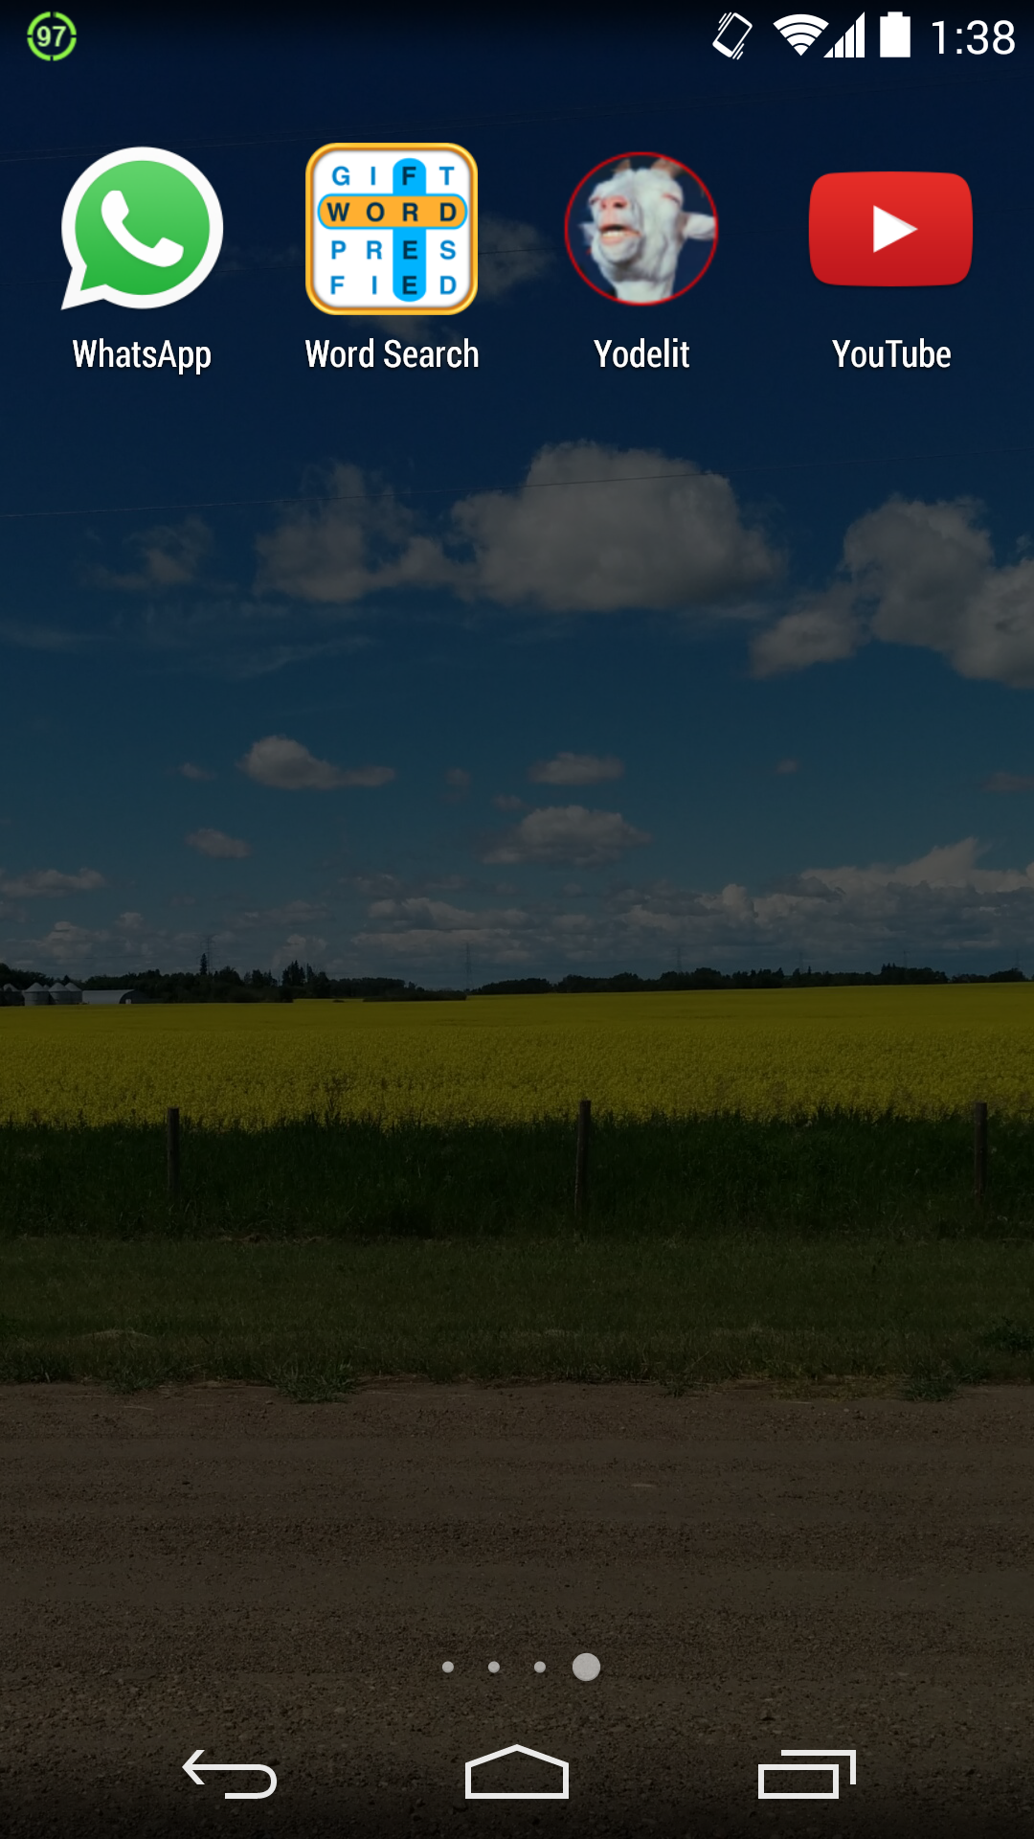
Let’s Yodel!
Notes:
Now, I just want to remind everyone that the app is still a work in progress, and that there will be quite a lot of differences between what you’re seeing right now, and what the final version will look like. But what we have developed right now is still a very good way to gauge the potential of the final product. On the screen right now is what it looks like for a user who is just about to open the YodelIt App. And, if you recall, here’s where we first introduce our screaming goat! Now, let’s click on the app button.

Slide 4
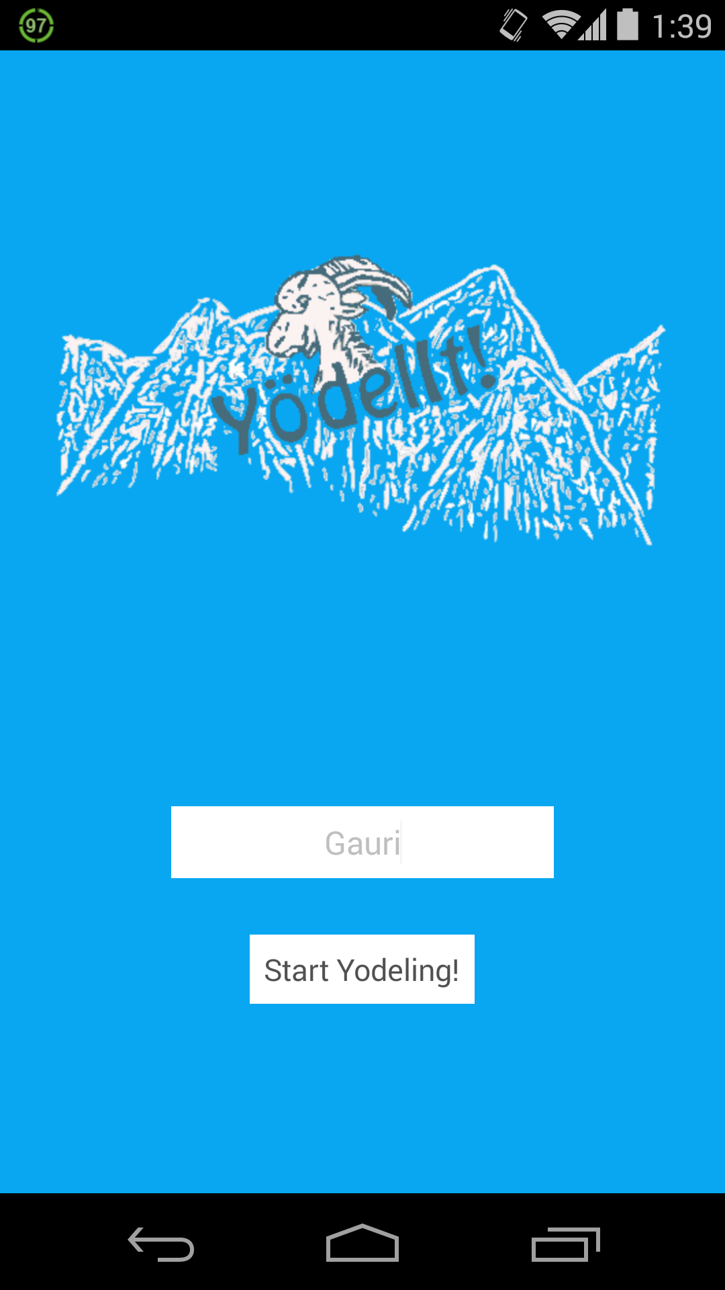
Login Screen
Notes:
The first screen that we see once we open the app, is the login page. Here, we have a very nice minimalist design scheme. Nothing at all which could potentially overwhelm a user. Because, let’s face it, we all hate it when we open an app and the first thing that we see is an ad for some game, or a long list of text. We’ve kept it nice and simple, with just our logo, a text box, and a button to enter into the app. Here, we’re going to try the app with my username.

Slide 5
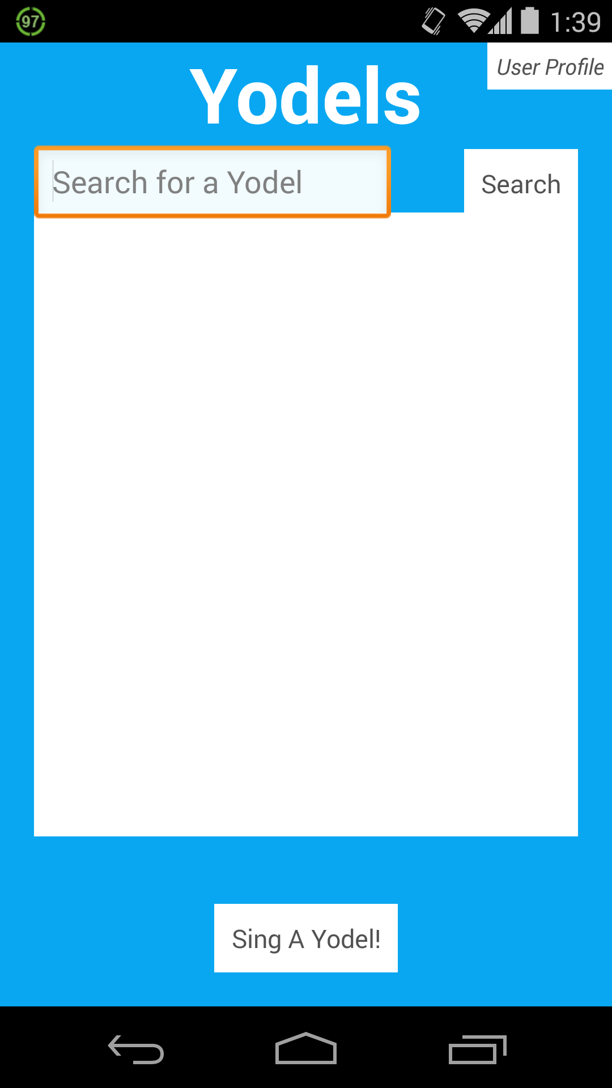
Main Screen
Notes:
Once we’ve logged into the app, we see our main screen which is basically a list of all of the Yodels on the server. Now here, we don’t have a Yodels yet, but that’s all part of the fun, and don’t worry we’re going to make a Yodel a little bit later on. Now, I’m going to draw your attention to the top right corner of the screen where we have a button for a user profile. It’s there and it’s editable, because let’s face, we’ve all made accounts once upon at time which might not have had the best usernames. But that’s okay, because we can definitely change things like that with a quick click of a button. And that’s really what we’ve strived to do here. Make an app that was very user friendly, and very easy to learn.

Slide 6
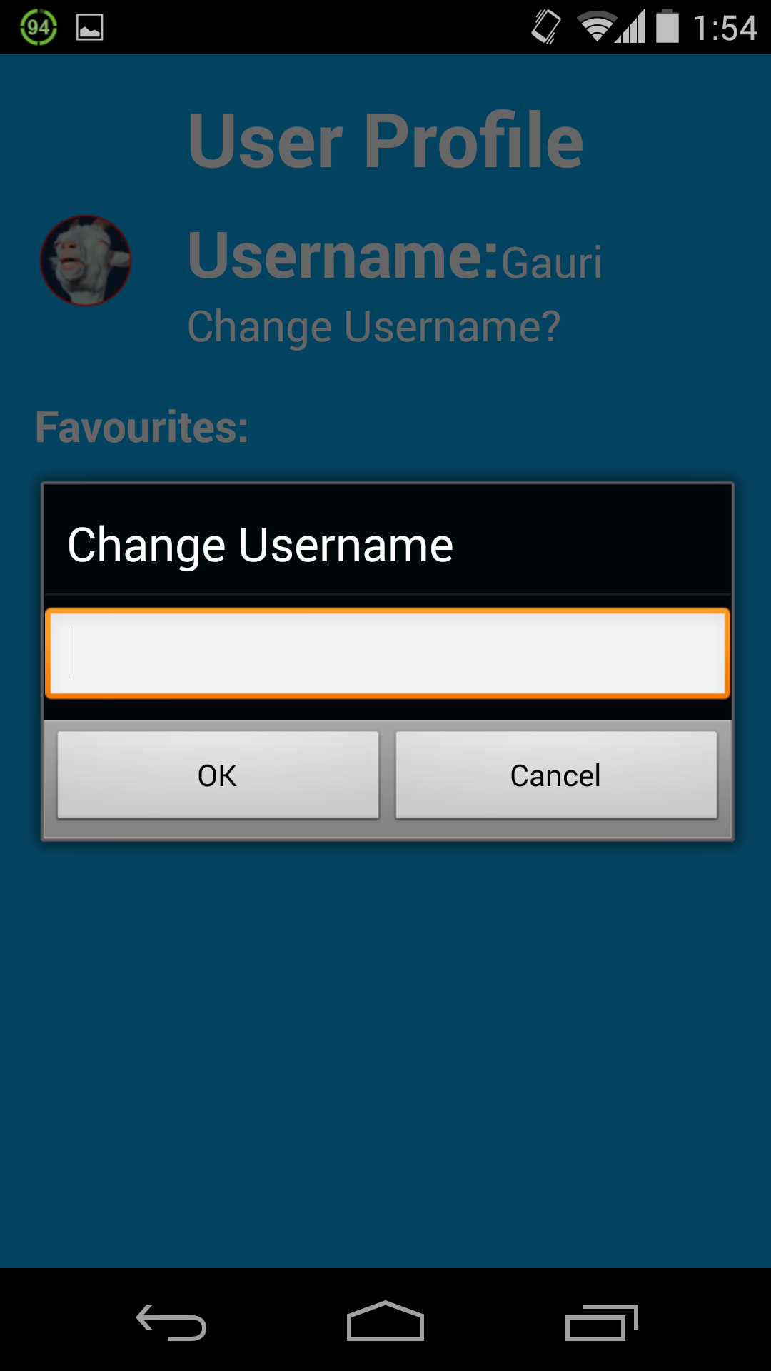
User Profile
Notes:
Here we are at the user profile screen. Now, what I’ve done here was click on the text, “Change Username?” and I’ve got this dialog box where I can change my username. Now, I’m actually okay with my username right now, but if I want to change it in a day or, become really anonymous or something, I can! I can also change what I want my profile icon to look like. Right now, I have our signature screaming goat, which I absolutely love, but I might think about changing that when I find a new, awesome picture online. So, since we won’t be making any changes to my user profile, we’re going to go on and Yodel a question!

Slide 7
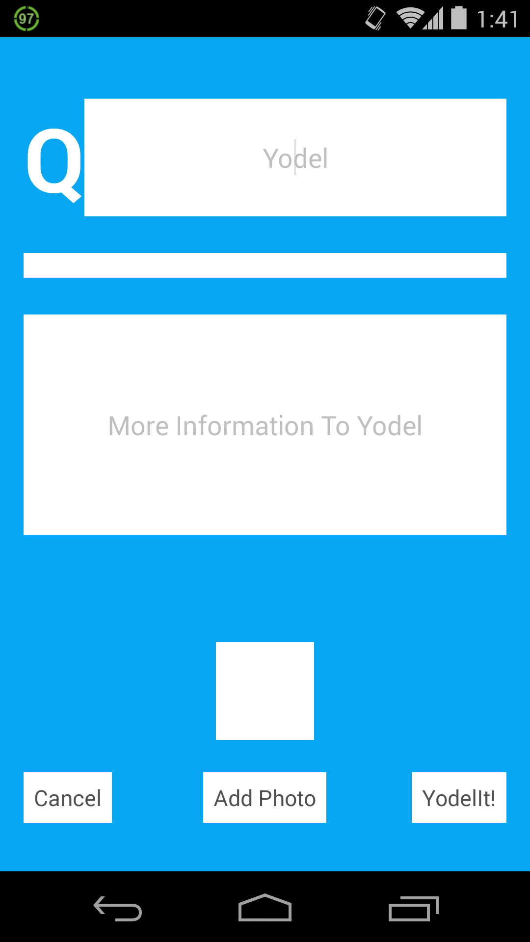
Creating a Yodel
Notes:
When we were back at the main screen, if I had pressed, “Sing a Yodel” we would have been directed to this screen. Here, I can Yodel a question, and even attach a picture! The little box above the “Add Photo” button is just to give you a clue as to where an image that I’d add to my question would be. But for now, I’m just going to Yodel a simple question, but yet one that has had me confused for years. And I’m telling the truth here.

Slide 8
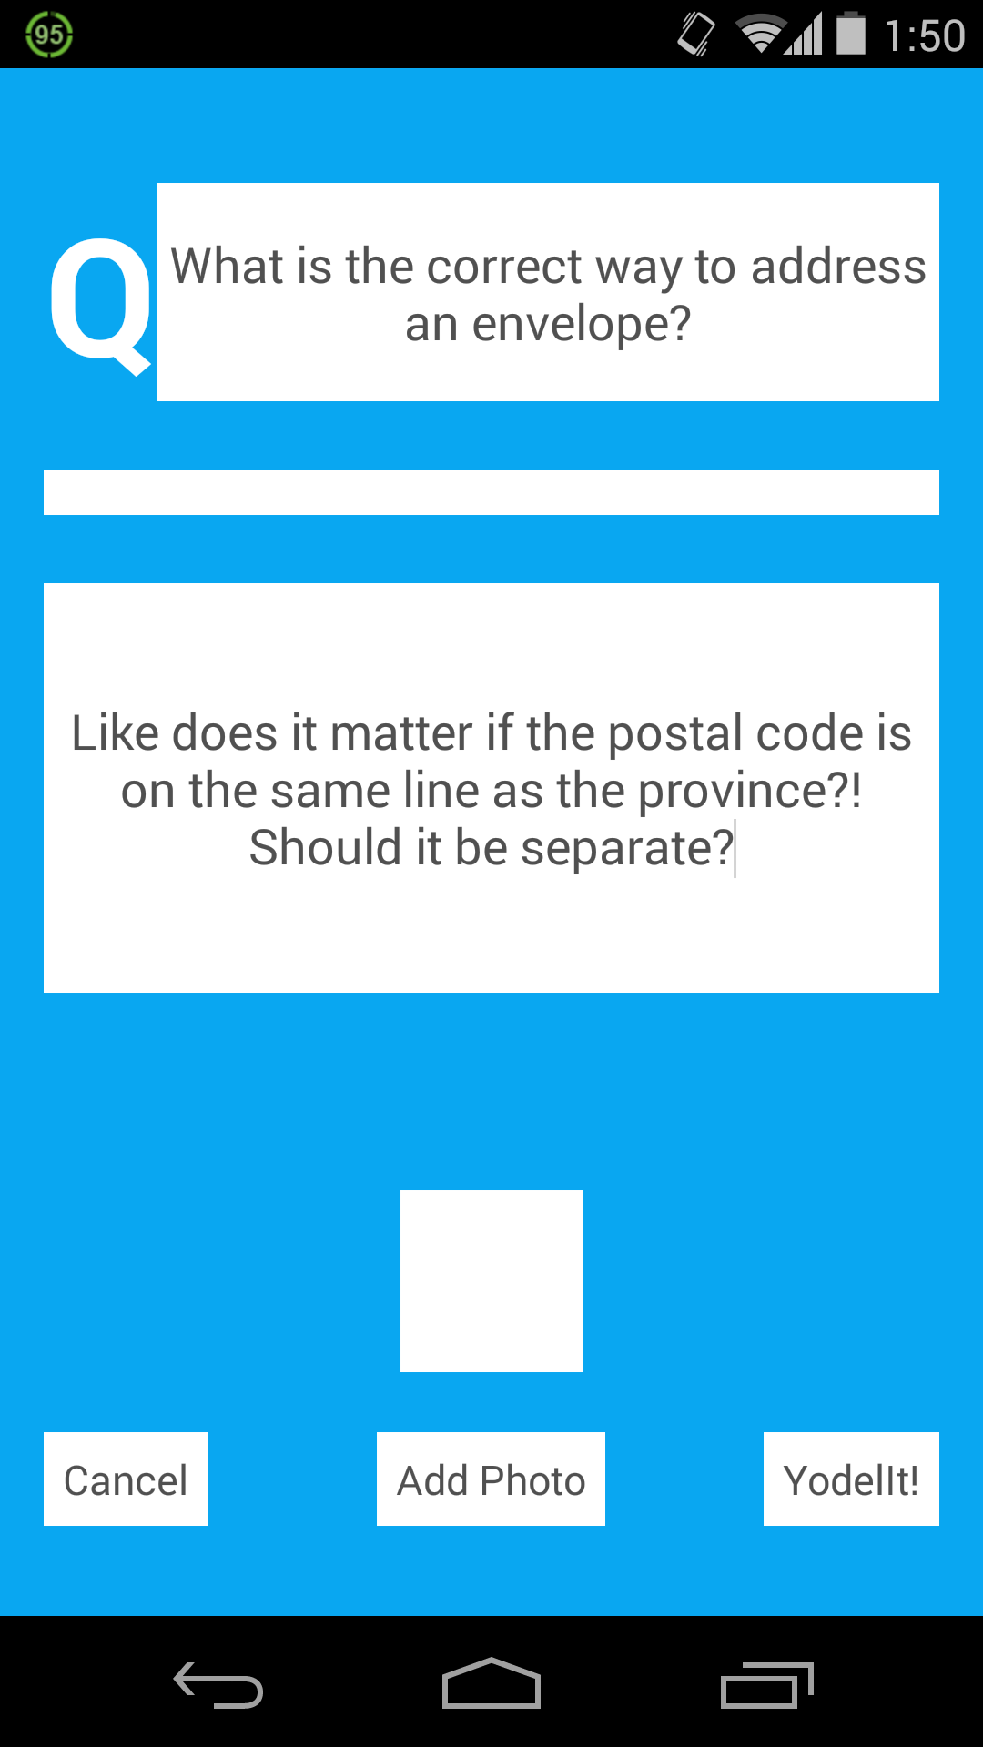
The Yodel
Notes:
And here is my Yodel! So, I’ve been really confused about this for a long time. I’ve seen people address envelopes with the post code on a separate line, and with the post code on the same line as the province. And I just don’t know what’s right! So, I thought that maybe this was an issue that YodelIt could solve! So, let’s Yodel my question, and see what happens!

Slide 9
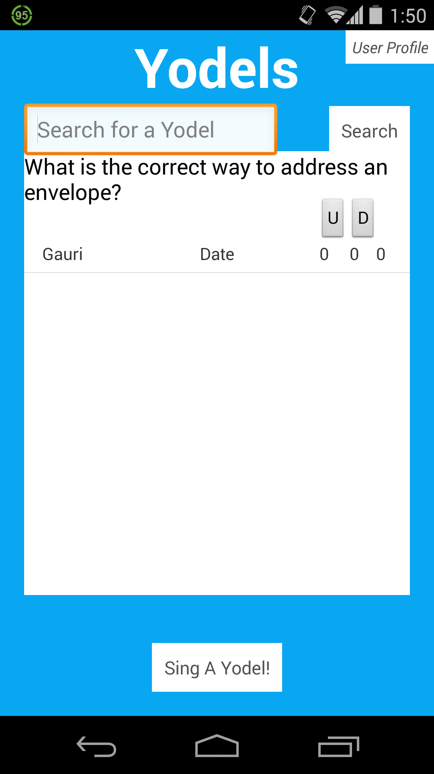
It’s been Yodelled
Notes:
So here is the updated main screen. My Yodel now appears, along with two small buttons to either upgoat or downgoat my Yodel. Upgoat or downgoat. Pretty self explanatory, and another way that YodelIt distinguishes itself from its competitors. And let’s face it! It’s real fun to say! I’m going to upgoat that! Much more interesting than simply liking something or giving something a thumb’s up.

Slide 10
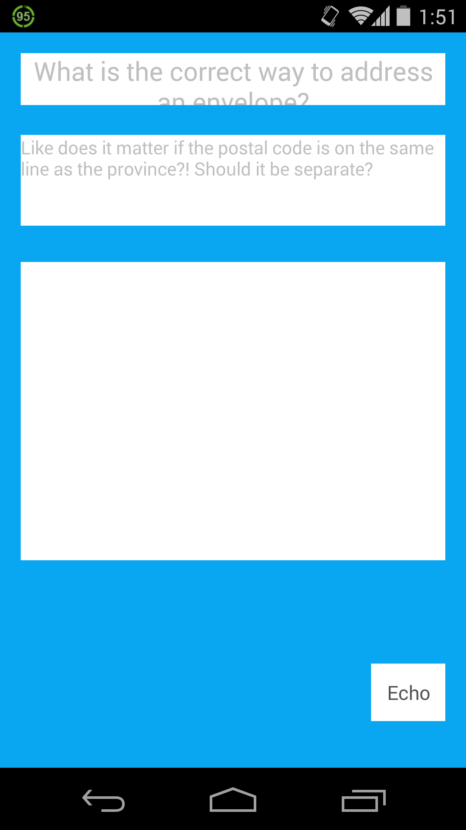
Viewing the Yodel
Notes:
Now, if we click on my Yodel, we’re redirected to this screen. And here, we see my original question, and the additional information that I added to it. There’s a white box at the bottom where all the replies to the Yodel, or Echoes would be. But right now, no one’s responded to my Yodel, so it’s blank. But, let’s say someone was viewing this, and they wanted to respond, they’d click on the “Echo” button. The term Echo comes from the story of Echo and Narcissus. A really long and sad love story that I encourage you all to read, but the gist of it is that Echo was only able to repeat the end of what was said to her, and that’s why she lost her love Narcissus. But to fair, Narcissus itself means excessive self-love. But anyways, Greek mythology aside, that’s why we still call the sound that we hear when we yell to a mountain an Echo. Because we can only hear the ending. But, it is a reply nonetheless and that is why any reply to a Yodel is called an Echo.

Slide 11
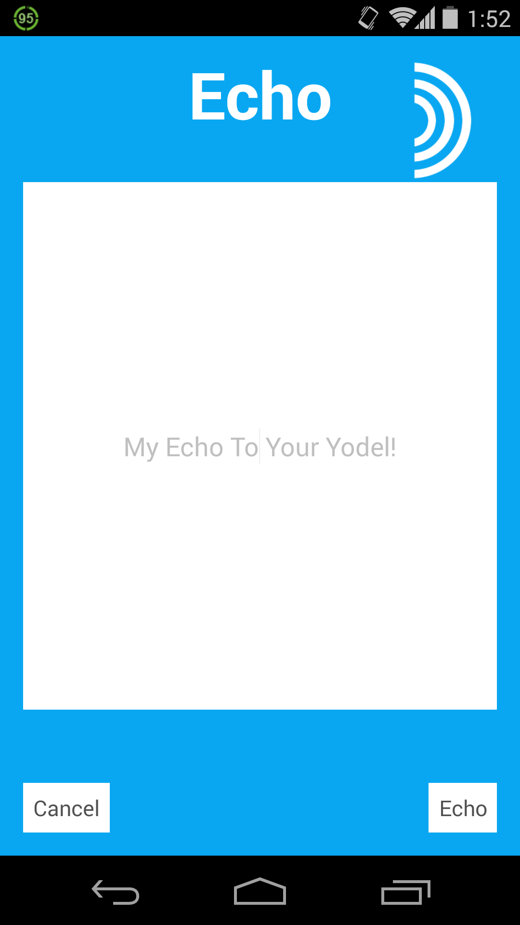
Echo Screen
Notes:
So, let’s say that someone knew the answer to my Yodel. They’d type it in to this page.

Slide 12
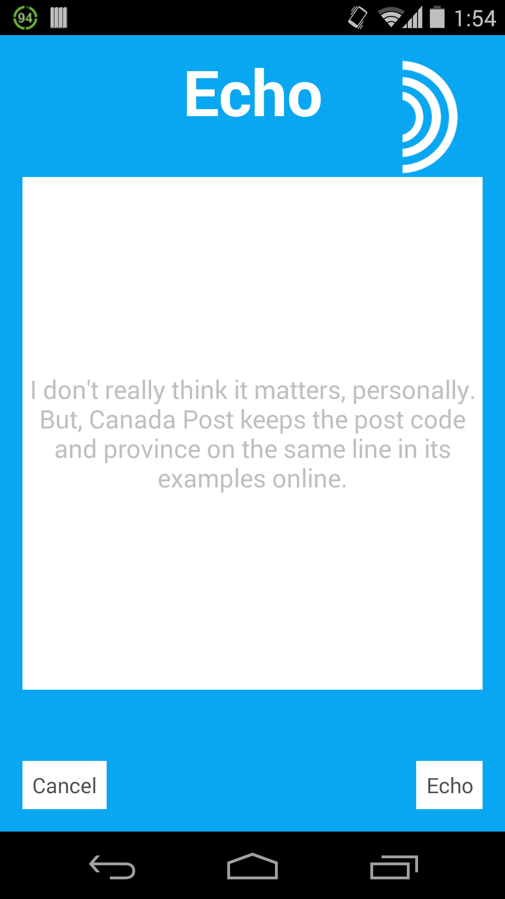
The Echo
Notes:
And according to what’s written here, Canada Post keeps the post code on the same line as the province. Interesting! I can honestly say that I did not know. But of course, in a live interaction of the app, I wouldn’t be able to read this until it was Echoed. So, let’s click “Echo” and see what happens.

Slide 13
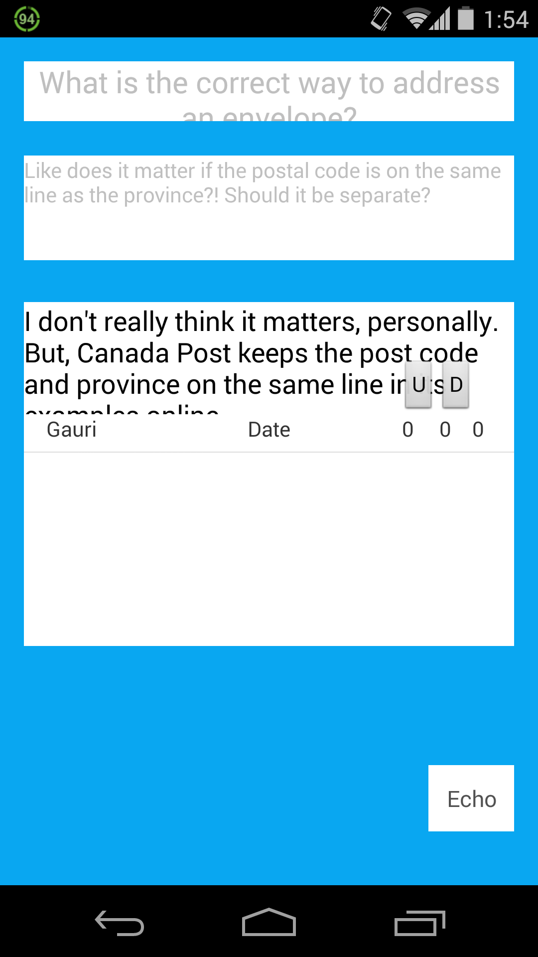
It’s been Echoed
Notes:
Here we see an updated version of the Yodel. My original Yodel along with the additional information is still there, but we also have an Echo. An Echo that can also be upgoated and dowgoated by users. So, personally, I really like the response to this Yodel. And not just because I was the one who wrote it. I think that I want to keep this Yodel/Echo so that I can refer back to it when I next need to address an envelope. To keep a list of the Yodels that I like, we’re going to have to go back to the main screen.

Slide 14
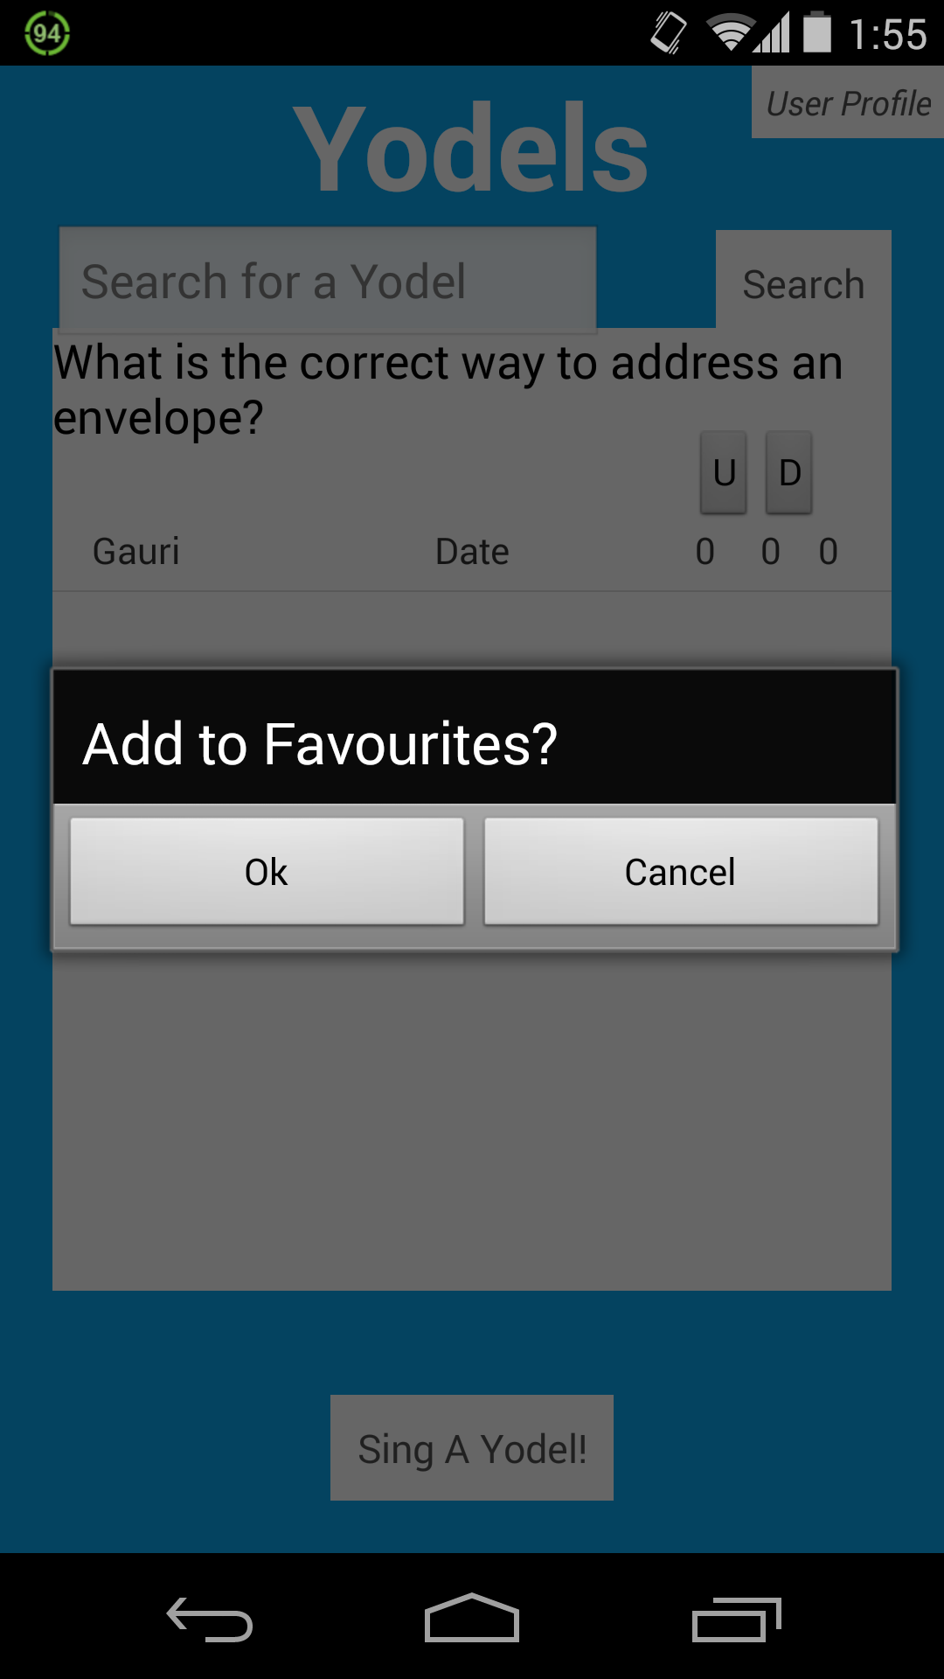
Add to Favourites
Notes:
Now that we’re back to the main Yodel screen, I can do a long click on my Yodel, and then I’ll get a dialog box where I can choose to add the Yodel to my list of Favourites. And if you remember, the list of Favourites is stored on the User Profile screen.

Slide 15
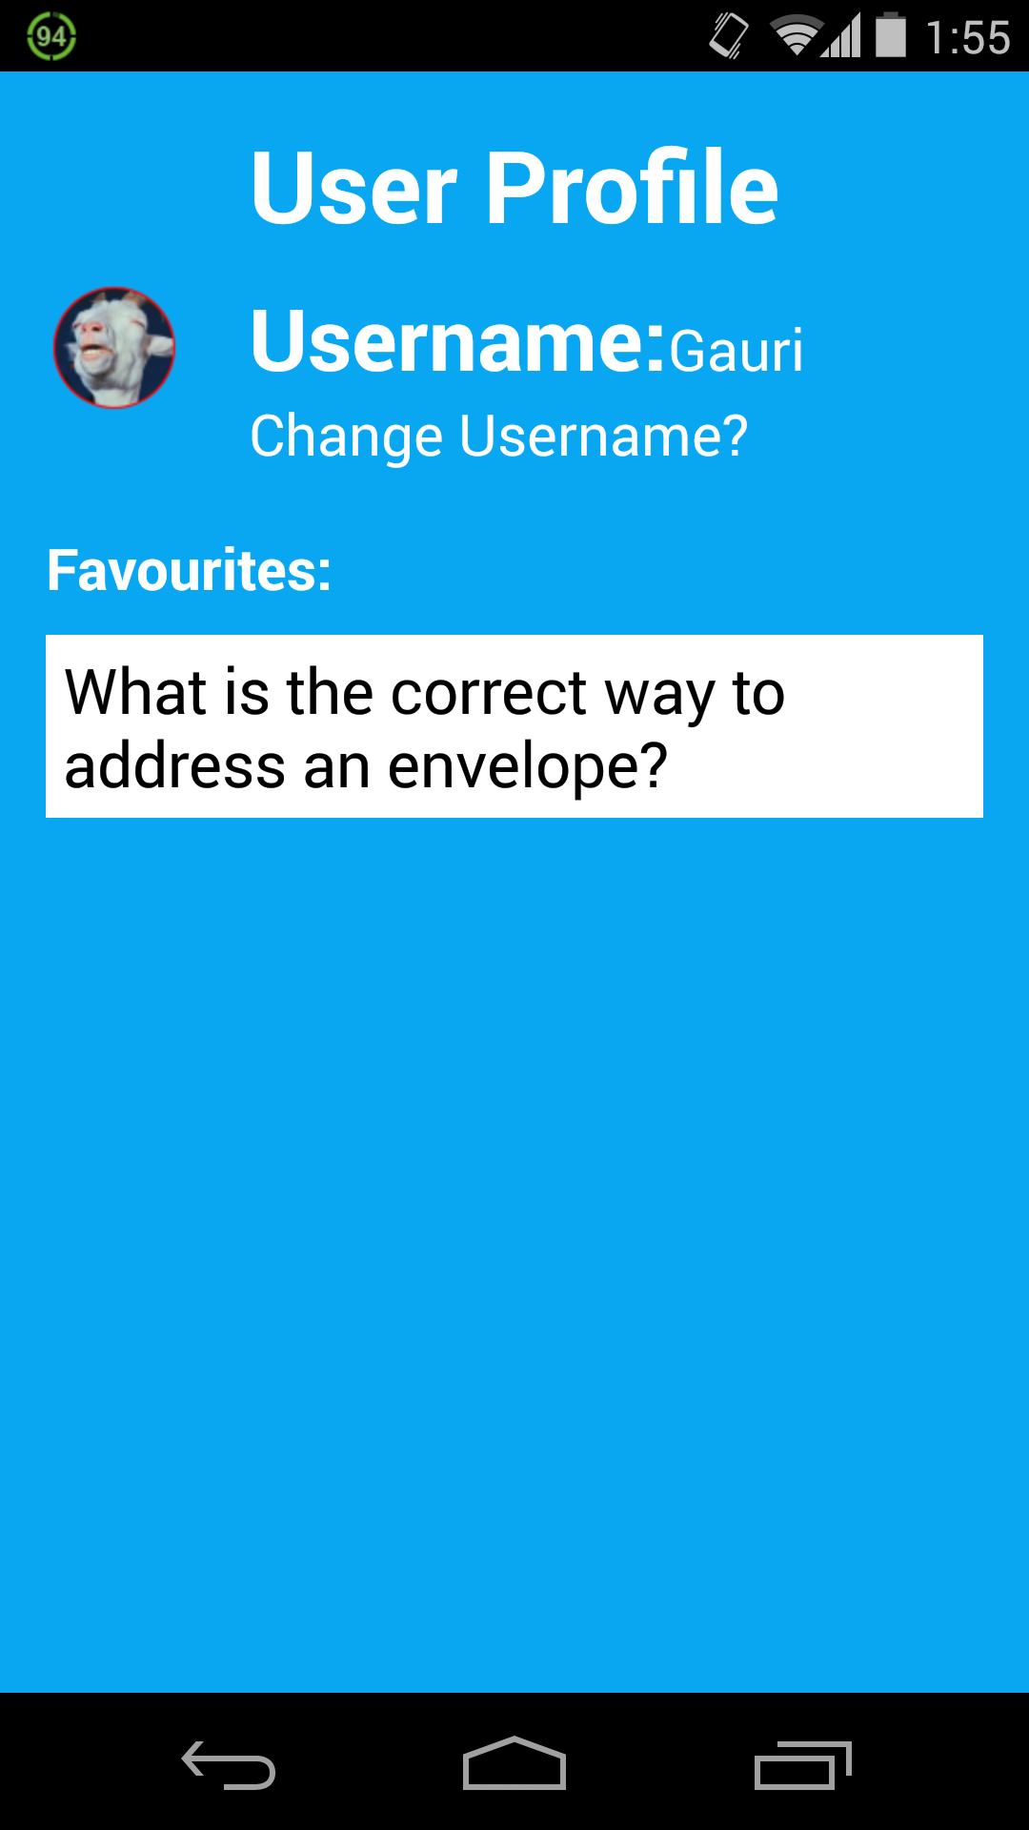
The Echo
Notes:
And here is what the list of Favourites looks like. It’s available for me to access at any time, online or offline, wherever I am. Convenient, right?

Slide 16
Conclusion
Notes:
And this brings us to the end of our demonstration of the YodelIt App. We hope that you’ve enjoyed this preview into the app, and we can’t wait to show you our finished product next week! Before we close, does anyone have any questions?

